Slide 1
Natural Gas: Game Changer Or Runner Left on Base? Working to Get it Right in CO!
Dr. Gary Graham
Director, Lands Program
Notes:
Show the quantity of ng potential, give caveats
Opportunities, Guidance, end with Don’t Bet Against American Innovation

Slide 2
Opportunity: A Clean Energy Future
Benefits:
Public Health: prevent illnesses, reduce medical costs
Environmental: climate, biodiversity, water, ecosystems
Economic: create domestic jobs, increase global competitiveness
National Security: more reliable supplies
Notes:
All are important
Env. WRA no debating, questioning, struggle hard to help solve
Public Health; 1365 and many others
ECON. My two sons entering job market
Security; lots of changes in oil rich countries, much instability remains and will so imp

Slide 3
Clean Energy Vision
An electric sector in the West that meets its share of IPCC target: 80% reduction below 1990 levels by 2050
Need about 100,000 MW new RE with aggressive EE, DR, and DG
Natural gas will occupy an important role in our transition to a clean energy future
www.cleanenergyvision.org

Slide 4
CEV Generation Portfolio
Notes:
Nuclear and Hydro held constant, RE past 2020 represents contribution from existing state RPSs
The NG portion of the portfolio will be important fluctuating somewhat around 150 Bkwhs, peaking in 2030 and then declining somewhat by 2050.
Can’t predict exact amount because a lot of variable involved from policy changes (or not) to economic recovery, tech innovation, investment incentives etc.

Slide 5
Use of NG Could Increase
With technological advances that increase efficiency
With additional carbon control and storage technologies
The interplay between the electricity and transportation

Slide 6
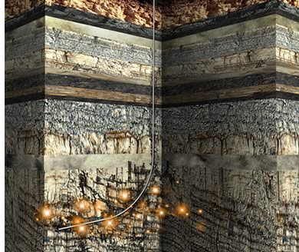
WRA’s Perspective
Ensure that natural gas plays an appropriate role in transitioning the western electricity sector to a lower carbon electricity mix, while also ensuring that natural gas extraction, production, and transportation are done in a way that safeguards our climate,
people and the region’s land,
wildlife, air and water.

Slide 7
Need for System Flexibility
Character of generation and loads is changing
More Variable Energy Resources (VERs) being added
Aging coal fleet being retired
Flexible gas resources complementing VERs, and together replacing carbon intensive coal resources
More electronic loads being added

Slide 8
Game Changer Challenges
Use of natural gas for electricity
Transition fuel
Extraction practices
Geography, ecology, safety and BMPs important
Efficiency, public perceptions, and community relations are important

Slide 9
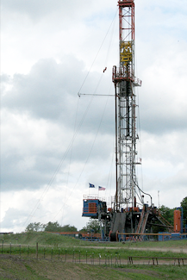
Challenges: Transition Fuel
Transition to 2050
Generate electricity from gas for capacity and flexibility, not as one-to-one base load fuel replacement
Gas alone does not get us there –
50 % less carbon is still too much
Underutilized gas generation now
Initial design and equipment
choices important

Slide 10
Challenges: Transition Fuel
NG complements more variable generation and does not displace RE or EE
Together NG, RE and EE replace aging coal generation
Locate new plants close to load
Minimize cost and transmission
Pipeline safety, fugitive emissions
Improve efficiency of gas plants
More cogeneration

Slide 11
Geography and Ecology Challenges
Protect wildlife habitat and wild places by foregoing some leases and carefully siting infrastructure on existing leases.
Avoid direct, indirect, and cumulative impacts (science is critical)
Minimize impacts through stakeholder and scientifically supported mandatory BMPs
Mitigate consistent with stakeholder supported requirements (no net loss)

Slide 12
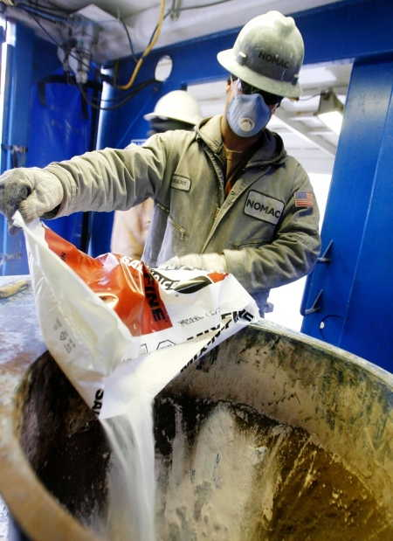
Geography and Ecology Challenges: Water
Use water efficiently
Minimize quantity, maximize quality
Report transparently water needs, acquisition and disposal
Avoid contamination of ground and
surface water
Adopt standards for minimum and
maximum casing and cementing for
wellbores
Ensure standards are protective

Slide 13
Geography and Ecology Challenges: Water
Implement and conduct mandatory baseline water testing, monitoring and tracing
Determine causation when fracking is a suspect in water contamination
Adopt more pitless development
Adopt standards for pit construction,
maintenance, and inspection
Ensure effective protection

Slide 14
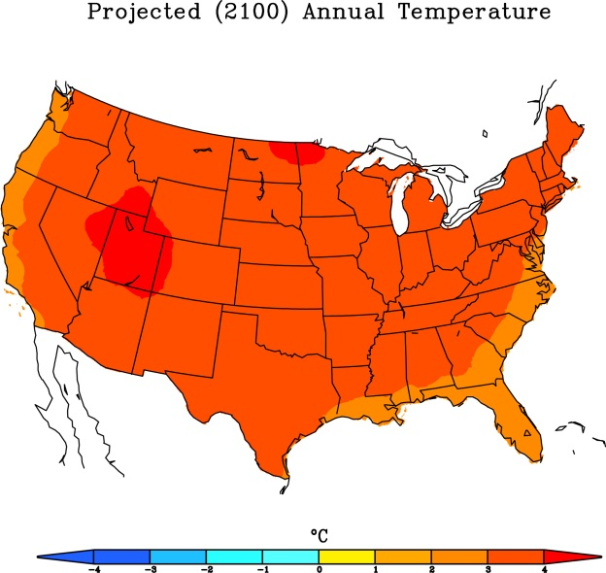
Geography and Ecology Challenges
Monitor and minimize climate impacts
Measure and report GHG emissions from all stages of oil and gas development
Support GHG performance standards for plants
Use infrared detection technology and pipeline maintenance programs to prevent fugitive emissions
Minimize flaring

Slide 15
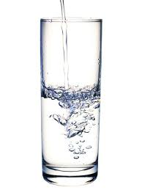
Solutions to Safety Challenges
Increase residential setbacks because longer distances from drilling rigs to homes can be the best protection for residents and their water wells
Make landowners whole with when operations impact their operations, water and/or health
Support local control regarding appropriate drilling proximity to homes and communities

Slide 16
Solutions to Safety Challenges
Require full public disclosure of all fracking constituents
Colorado now a model for other states
Help fund and conduct health impact studies to adequately address public health risks

Slide 17
Benefits for Oil and Gas Industry
Putting causation issues to rest: If scientific testing, monitoring and tracers determine causation, industry can’t be blamed for pollution where the evidence doesn’t indicate oil and gas is the cause
Financial: Industry can improve its bottom line by capturing fugitive methane emissions and keeping gas in the pipeline thus reducing climate impacts
Improved relationships: Landowners respect industry for being good neighbors and making good on their bargain to make things right if something goes wrong

Slide 18
Benefits for Oil and Gas Industry
Improved partnerships. Conservationists can recognize that natural gas has a legitimate role as firming power as we accelerate the transition to a cleaner grid
Pre-drilling analysis. Conservationists can agree that streamlined review is appropriate for drilling permits tiered to comprehensive development plans. Once such plans are approved, industry has regulatory certainty on its ability to implement its drilling plan

Slide 19
Next Steps
All be open to suggestions and discussion:
we don’t pretend to have all the answers
Acknowledge the challenges and need for communication and collaboration
Industry has a major role in contributing its technical expertise to developing workable solutions
Increase use of existing gas fleet
Enable most efficient gas to retire least efficient coal
Procure gas to supply electrical generation capacity and flexibility

Slide 20
Next Steps
Develop plan with state agencies (including CDNR, COGCC & CDPHE), NGOs, and State Universities to develop solutions, BMPs and policy responses to priority issues
Coordinate with BLM, EPA and other appropriate federal partners
DOE shale gas advisory committee: 20 specific recommendations, large & small

Slide 21
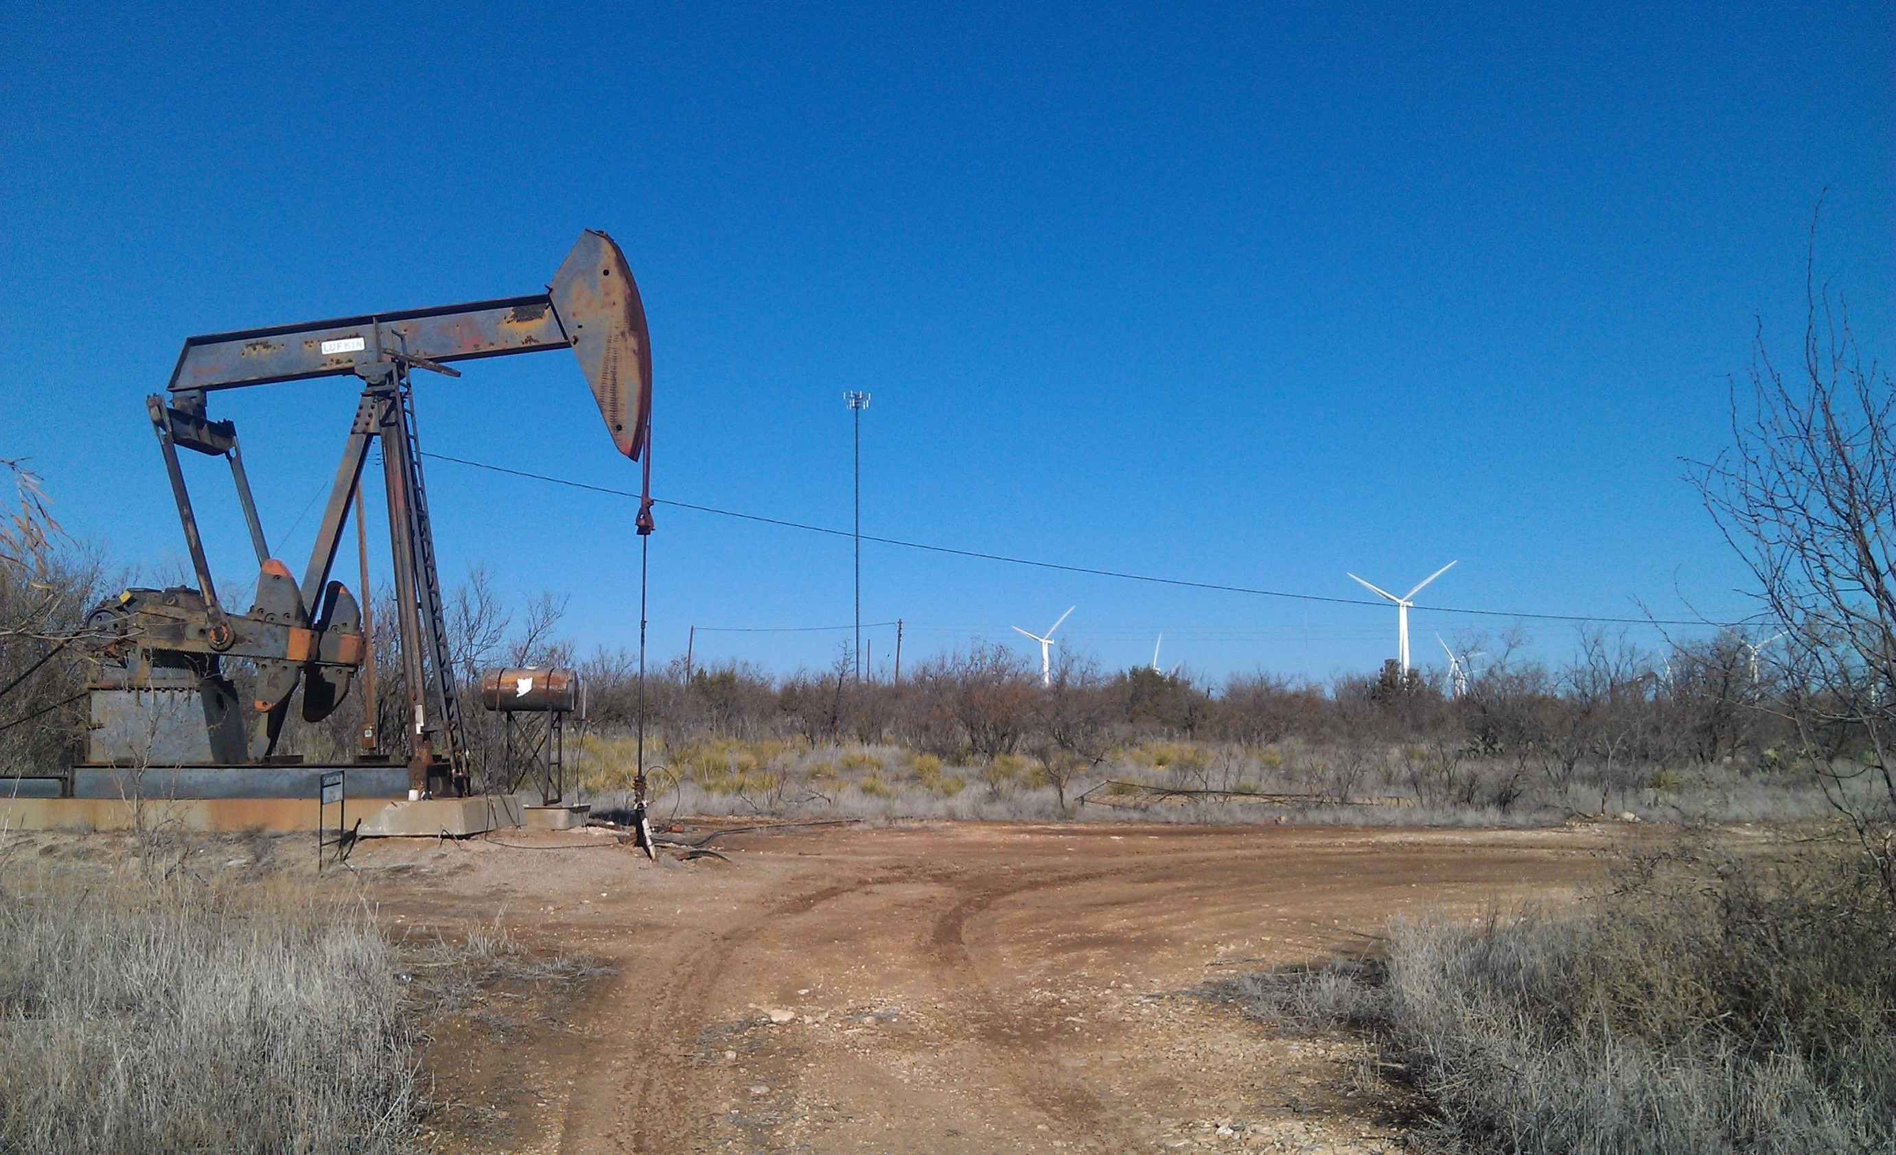
Our collective energy future is critically important and very complex. We have to “get it right” working together with honest straightforward dialogue
Let’s “get er done”

